Slide 1




submitted by
Pet store Analysiss
Submitted by: Habiba Mohamed
GitHub

Slide 2

Home
Service
About Us
Contact
Habiba Mohamed
A Business Information Systems graduate with a strong passion for data analysis and insights-driven decision-making. In this project, I performed data cleaning and analysis using Python, built interactive reports in Power BI, and established data relationships to deliver comprehensive and actionable insights.

Slide 3

Home
Service
About Us
Contact
Overview
Project Name:
Pets store Analysis
Objective: To analyze sales trends, customer behaviors, and product performance using Python, Excel and Power BI.
Tools Used: Python (Pandas, Matplotlib, Seaborn), Excel, SQL, Power BI.
01
02
03

Slide 4
Home
Service
About Us
Contact
Data Collection
Datasets Used:
dim_customers: Customer details (Customer ID, Order City, Order State).
dim_products: Product details (Stock Code, Weight, Landed Cost, Shipping Cost, Category, Description).
fact_sales: Sales transactions (Transaction Date, Customer ID, Product Description, Stock Code, Invoice No, Quantity, Sales, Unit Price).
state_region_mapping: Mapping of states to regions for geographic analysis.

Slide 5


Optimize High-Performing Categories
Home
Service
About Us
Contact
Goals & Business Objectives
01
Drive Revenue Growth
02
Optimize High-Performing Categories
03
Improve Cost Efficiency
04
Capitalize on Demand Trends
2
h

Slide 6

Home
Service
About Us
Contact
Data Cleaning and Processing By Paython
Importing Data and Libraries
01
03
Initial Data Inspection
02
Checking Missing Values and Duplicates
03
04
Handling Missing Values
2
Removing Outliers
05
06
Fixing Data Types
07
Text Cleaning and Standardization
08
Removing Duplicates and Merging Invoices

Slide 7
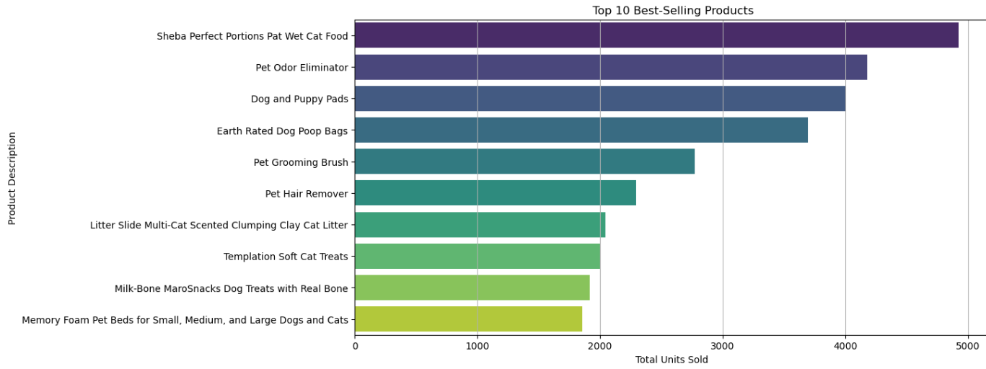
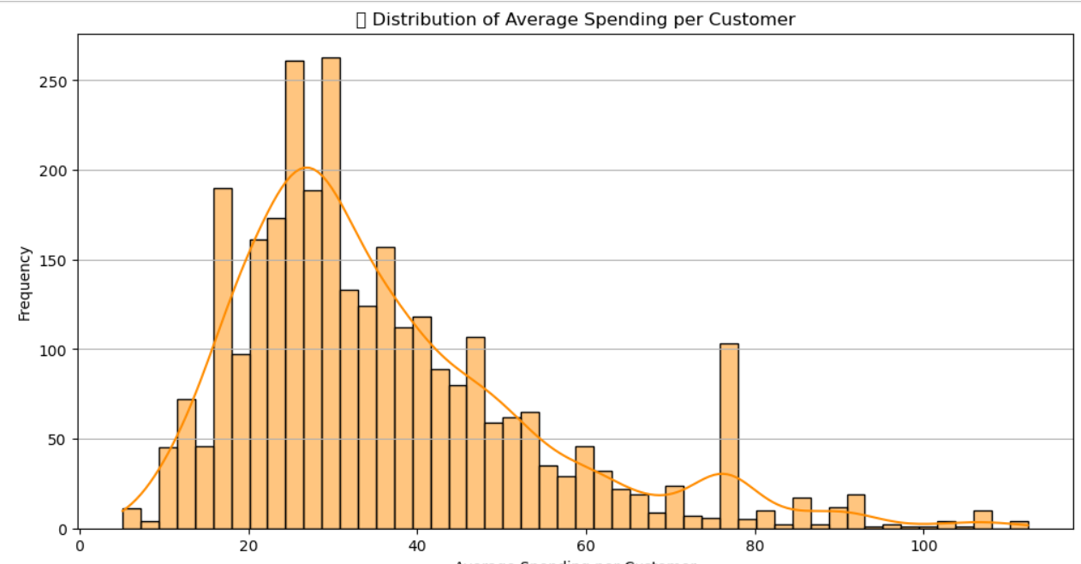
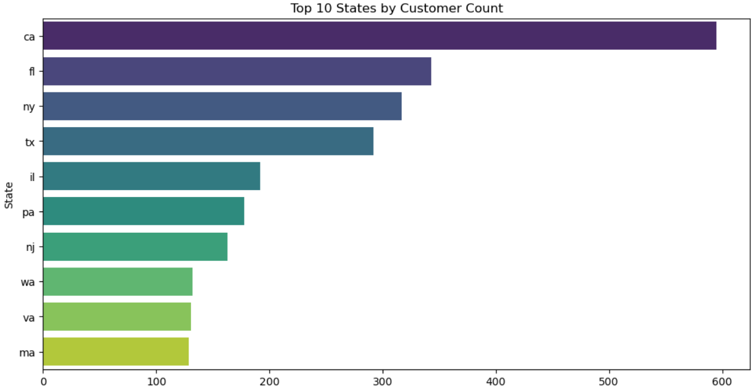
Some visualizations by Python

Slide 8
Home
Service
About Us
Contact
Analyze data in Excel file
Data Processing & Consolidation
01
03
Create poviet tables
02
01
Sales Performance Analysis - Bar Chart
02
Sum of Sales - Pie Chart
2
Compare Weight to Shipping - Column Chart
03

Slide 9
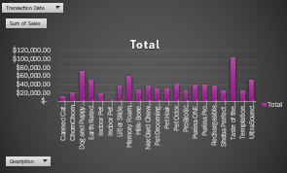
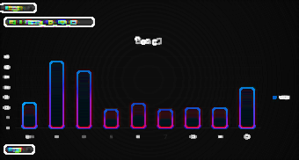
Some visualizations by Excel

Slide 10
Home
Service
About Us
Contact
Data Preparation and Relationships in Power BI
Data Preparation & Modeling
01
03
Create relationships between tables and determine their type
02
03
Making new measure
04
Create Blue Print
2
Data Visualization
05

Slide 11
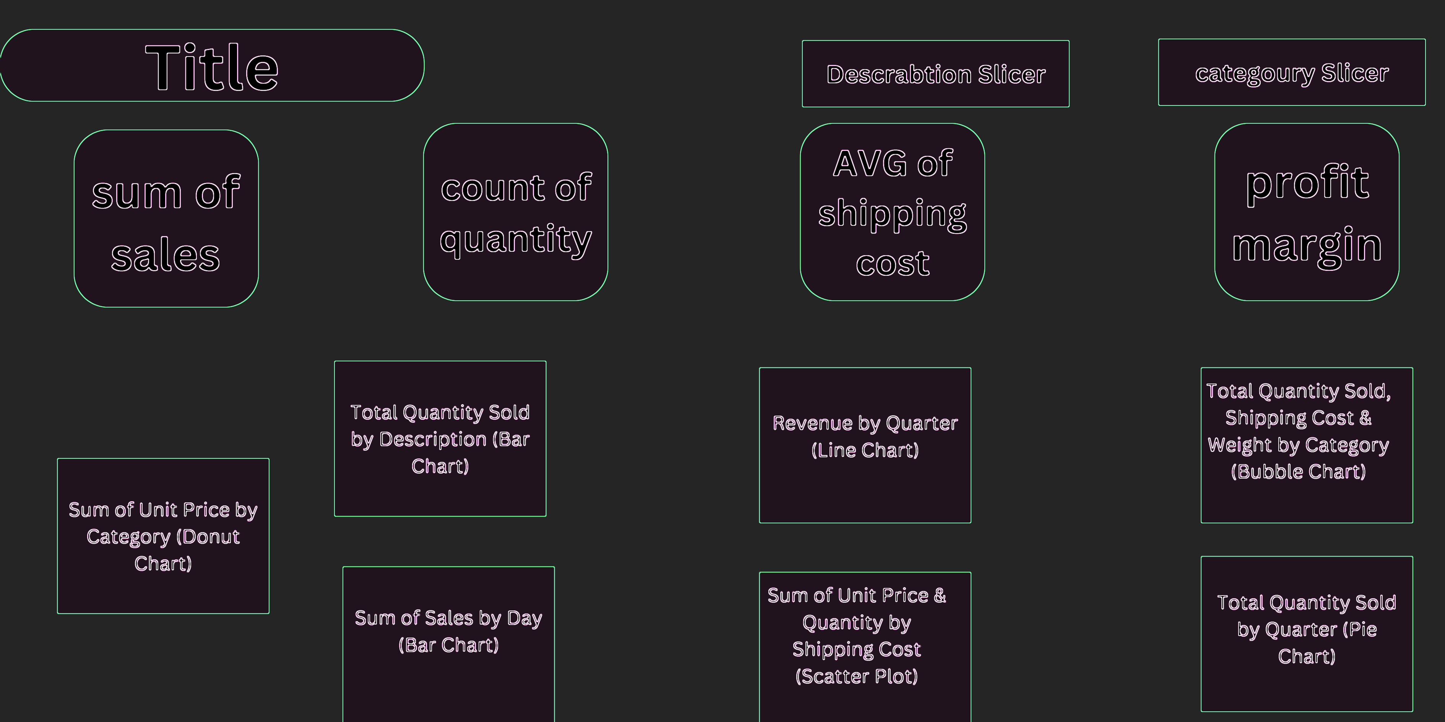
Home
Service
About Us
Contact

Slide 12
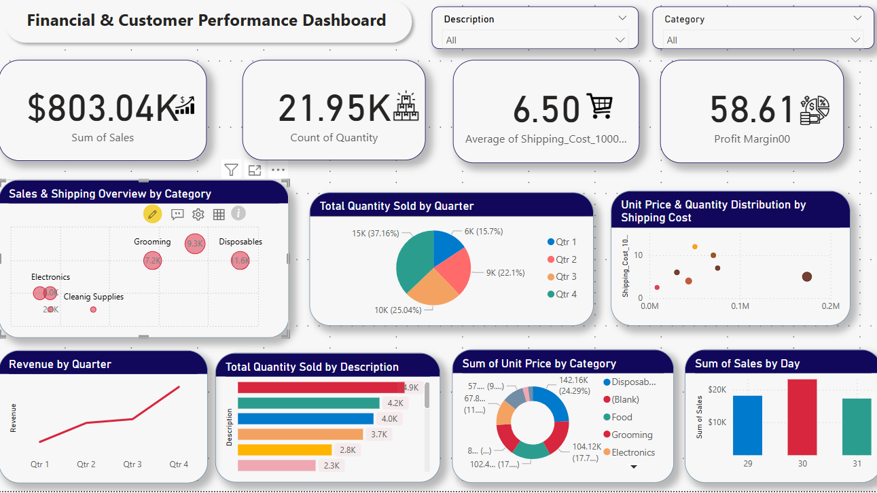
Home
Service
About Us
Contact

Slide 13
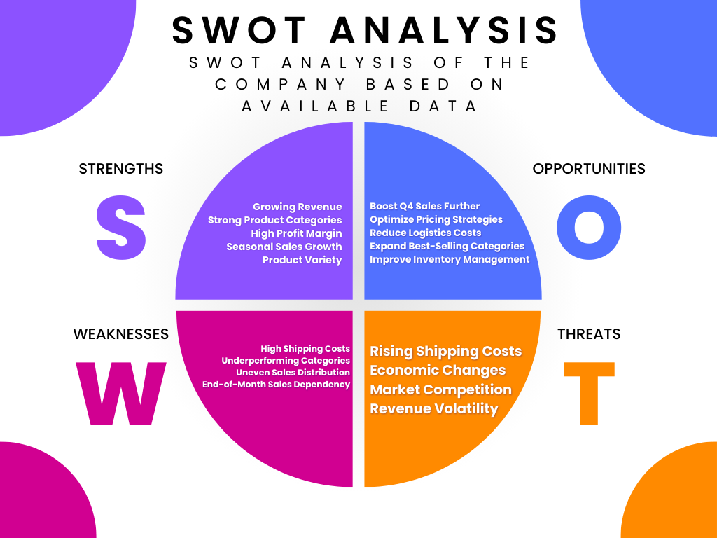
Home
Service
About Us
Contact

Slide 14
Home
Service
About Us
Contact
Increase Marketing in High-Performing Regions to boost sales further.
Optimize Shipping Costs for low-margin products.
Focus on Customer Retention Strategies such as loyalty programs and personalized discounts.
Improve Inventory Management based on seasonal demand forecasts.
Recommendations

Slide 15

Home
Service
About Us
Contact
Conclusion & Next Steps
Project Impact: Data-driven decisions to improve sales performance and customer targeting.
Future Work: Implement machine learning models to predict future sales trends.

Slide 16

submitted by
Thank You!
Submitted by: Habiba Mohamed
Linkedin

